Slide 1

A MINI PROJECT ON
“SMART PARKING DECK”
UNDER THE GUIDENCE OF:
Prof. Revati Sugoor
SUBMITTED BY:
GANESH RATHOD (SG22AID018)
MAHEEN SULTANA (SG22AID023)
MALLIKARJUN (SG22AID024)
SHRUSTI KULKARNI (SG22AID044)

Slide 2

SMART PARKING DECK

Slide 3
INTRODUCTION
With the rapid increase in urban population and vehicle ownership, finding an efficient and convenient parking space has become a major challenge. Traditional parking systems often result in traffic congestion, fuel wastage, and frustration among drivers. To address these issues, Smart Car Parking Systems have emerged as an innovative solution, integrating advanced technologies such as the Internet of Things (IoT), sensors, cloud computing, and mobile applications.
A Smart Car Parking System automates the process of locating and reserving parking spaces, reducing human intervention and optimizing space utilization. Sensors placed in parking lots detect vehicle presence, providing real-time data to users via mobile apps or digital displays. These systems also support cashless payments, enhancing convenience and efficiency.
The implementation of smart parking solutions benefits both users and city authorities. It minimizes search time, decreases fuel consumption, and reduces carbon emissions. Moreover, it helps urban planners optimize land use and improve traffic flow. This report explores the working mechanism, advantages, challenges, and future scope of Smart Car Parking Systems in modern urban settings.

Slide 4
LITERATURE SURVEY
Shastri, A., and Singh, R. [1] propose a smart parking solution based on wireless sensor networks (WSN) deployed in multi-level parking lots. This system capitalizes on ZigBee protocol for sensor data communication to maintain low power consumption. Sensors placed at each parking slot detect the presence of vehicles and relay real-time status to a central coordinator. The system also supports historical data analysis to predict peak parking times and optimize management. Limitation: Their system is less suitable for outdoor parking lots where signal interference and environmental factors may affect wireless communication quality.
Wang, C. et al. [2] investigate an IoT-enabled smart parking system that incorporates vision-based sensing technologies complemented by ultrasonic sensors. The system uses cameras strategically positioned to capture parking occupancy while ultrasonic sensors provide supplementary data for confirmation. These inputs are processed via edge computing units to reduce data transmission latency. The system aims for a high detection accuracy and real-time response. Limitation: Camera-based solutions raise privacy issues and require substantial processing power and bandwidth.

Slide 5
OBJECTIVES
To detect vehicle presence in individual parking slots,Use IR sensors to monitor and detect whether each slot is filled or empty, and continuously update this status in real time.
To control gate/barrier access automatically,Implement servo motors to raise or lower the entry gate based on slot availability and vehicle detection at the entrance.
To display live slot status on an LCD screen,Integrate a 16x2 LCD module to visually show the status of all parking slots (e.g., Slot 1: Fill, Slot 2: Empty), helping users identify available slots.
To manage system power through regulated supply,Use a 5V 2A adapter and voltage regulator to safely power the Arduino and all connected components.
To integrate Arduino Uno as the central controller,Program the Arduino Uno to coordinate sensor input, LCD output, and servo control, ensuring synchronized and responsive operations.
To develop a cost-effective prototype for small parking facilities,Demonstrate a scalable, low-cost solution suitable for educational campuses, offices, or small shopping complexes.

Slide 6
SYSTEM ANALYSIS
Existing System
In traditional parking systems, most operations are manual or semi-automated. Users have to:
Search for parking slots physically, which wastes time and fuel.
Manually check slot availability, often resulting in congestion and improper space utilization.
Rely on human operators for gate control and parking management.
Proposed system
The Proposed Smart Parking System automates parking space monitoring and access control using Arduino and embedded components:
IR Sensors are used to detect the presence of vehicles in each slot.
Real-time Slot Status is displayed on a 16x2 LCD, clearly showing which slots are filled or vacant.
A Servo Motor Gate System is used to control vehicle entry, opening only when slots are available.
An Arduino Uno is used as the central controller to handle all input and output operations.
Efficient Power Supply (5V, 2A adapter) ensures smooth operation of all hardware components.
Improved User Experience by guiding vehicles directly and reducing traffic within the parking area.

Slide 7
LITERATURE SURVEY
Shastri, A., and Singh, R. [1] propose a smart parking solution based on wireless sensor networks (WSN) deployed in multi-level parking lots. This system capitalizes on ZigBee protocol for sensor data communication to maintain low power consumption. Sensors placed at each parking slot detect the presence of vehicles and relay real-time status to a central coordinator. The system also supports historical data analysis to predict peak parking times and optimize management. Limitation: Their system is less suitable for outdoor parking lots where signal interference and environmental factors may affect wireless communication quality.
Wang, C. et al. [2] investigate an IoT-enabled smart parking system that incorporates vision-based sensing technologies complemented by ultrasonic sensors. The system uses cameras strategically positioned to capture parking occupancy while ultrasonic sensors provide supplementary data for confirmation. These inputs are processed via edge computing units to reduce data transmission latency. The system aims for a high detection accuracy and real-time response. Limitation: Camera-based solutions raise privacy issues and require substantial processing power and bandwidth.

Slide 8
ADVANTAGES
Time Efficiency: Drivers spend less time searching for parking spaces, reducing congestion and frustration.
Optimized Space Utilization: Parking spaces are efficiently managed, ensuring maximum usage of available spots.
Convenience: Features like real-time space availability, reservations, and automatic payments make the parking experience more convenient for users.
Reduced Traffic Congestion: By guiding drivers directly to available parking spaces, the system reduces unnecessary driving and decreases traffic within parking lots.
Environmentally Friendly: Reduced search time for parking spaces leads to lower fuel consumption and reduced emissions, contributing to a greener environment.

Slide 9
DISADVANTAGES
High Initial Cost: The installation of sensors, communication infrastructure, software, and other required technologies can be expensive for parking lot operators or city planners.
Maintenance and Upkeep: Regular maintenance of sensors, hardware, software, and communication systems is needed to ensure smooth operation, which can be costly and time-consuming.
Privacy Concerns: The use of technologies like license plate recognition (LPR) or surveillance cameras can raise privacy issues among users, as it involves data collection and tracking of vehicles.
Dependence on Technology: A smart parking system is highly reliant on technology. If there is a system failure, malfunctioning sensors, or technical glitches, it can cause inconvenience to drivers and parking lot operators.

Slide 10
SYSTEM REQUIREMENTS
Hardware Requirements
Arduino Uno (1 unit) – Microcontroller
IR Sensors (6 units) – Vehicle detection in each slot
16x2 LCD Display – Shows slot status
Servo Motor – Controls entry gate
5V, 2A Adapter – Power supply
Breadboard & Jumper Wires – Circuit connections
Resistors, Connectors – Supporting components
Software Requirements
Arduino IDE – Code writing and uploading
Embedded C / Arduino C++ – Programming language
(Optional) Fritzing/Proteus – Circuit simulation
MS Word / PowerPoint – Project documentation

Slide 11
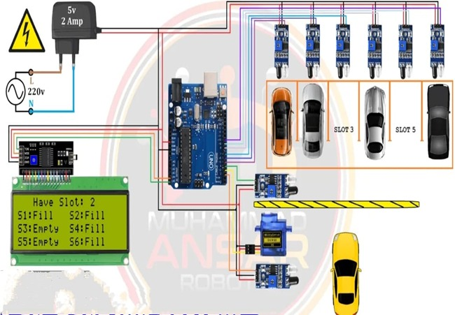
RESULT

Slide 12
CONCLUSION
The Smart Parking System using Arduino offers an efficient and cost-effective solution to manage parking spaces, especially in small-scale environments like colleges, offices, and shopping complexes. By using IR sensors, LCD display, and servo motors controlled through an Arduino Uno, the system provides real-time monitoring of parking slot availability and automates gate access.
This project not only reduces manual effort and traffic congestion but also enhances user convenience through automation. It serves as a practical step toward smarter infrastructure and can be further expanded with IoT integration for remote access and mobile app support.

Slide 13
REFERENCES
www.arduino.cc – Arduino official documentation
www.electronicshub.org – IR sensor details
circuitdigest.com – LCD and servo motor interfacing
create.arduino.cc – Arduino project examples
ieeexplore.ieee.org – Smart parking system research papers
fritzing.org – Circuit design and simulation

Slide 14
THANK YOU
GANESH MAHEEN MALLIKARJUN SHRUSTI

